Slide 1
Risk Analysis of Lending Club’s Loan Offerings
James Rogers
Risk Analyst, Lending Club Corporation

Slide 2
Agenda
What is the Lending Club
Purpose
Background
Dataset Details
Exploratory Data Analysis
Journey with Dataset
Data Wrangling
Descriptive Statistics
Data Snapshot
Possible Opportunities for Increased Productivity
FICO Risk Score
Regional Markets
Employment Length
Summary
Questions

Slide 3
What is the Lending Club
Lending Club is a peer to peer lending company based in the United States, in which investors provide funds for potential borrowers and investors earn a profit depending on the risk they take (the borrowers credit score).
Lending Club provides the "bridge" between investors and borrowers. It was the first peer-to-peer lender to register its offerings as securities with the Securities and Exchange Commission (SEC), and to offer loan trading on a secondary market. Lending Club is the world's largest peer-to-peer lending platform.

Slide 4
Purpose
Identifying possible solutions in this capstone will provide insight as to how real business problems are solved using a variety of technological platforms.
During this capstone, a basic understanding of risk analytics in banking and financial services will be achieved as well as an understanding how data is used to minimize the risk of losing money while also emphasizing increased productivity.

Slide 5
Background
Drew Minkin and Rachael Ridenour at Lending Club’s Corporate Office has been directly tasked by the Chief Executive Officer to get to the bottom of Lending Club’s declining loan closings.
a
Drew and Rachael reached out to top analyst, James Rogers who had been enjoying a day at the lake while vacationing for the first time since retiring from the U.S. Air Force.
They thought it would be a great chance to for James to shine being that he’s ready for advancement beyond his entry level analyst role.

Slide 6
Dataset
Dataset was found at:
- https://www.kaggle.com/wordsforthewise/lending-club
Dataset comprised of 2 separate files titled:
‘accepted_2007_to_2018Q4.csv.gz’
‘rejected_2007_to_2018Q4.csv.gz’
Dataset size
‘accepted…’ has 2.2 million rows and 114 columns
‘rejected…’ has 27 million rows and 9 columns
Carved out a portion of each set by date
Date range for ‘accepted’ 2015-2016
Date range for ‘rejected’ 2nd quarter, 2016
Excel and Python were the primary tools deployed to review .csv files to conduct an analysis on the years 2007 – 2018

Slide 7
Exploratory Data Analysis – The Journey
Unzipping the zipped .csv files
File too large for Excel
Deleting extra columns
Removing null values and blanks
Carving out the right data
1
2
3
4
5

Slide 8
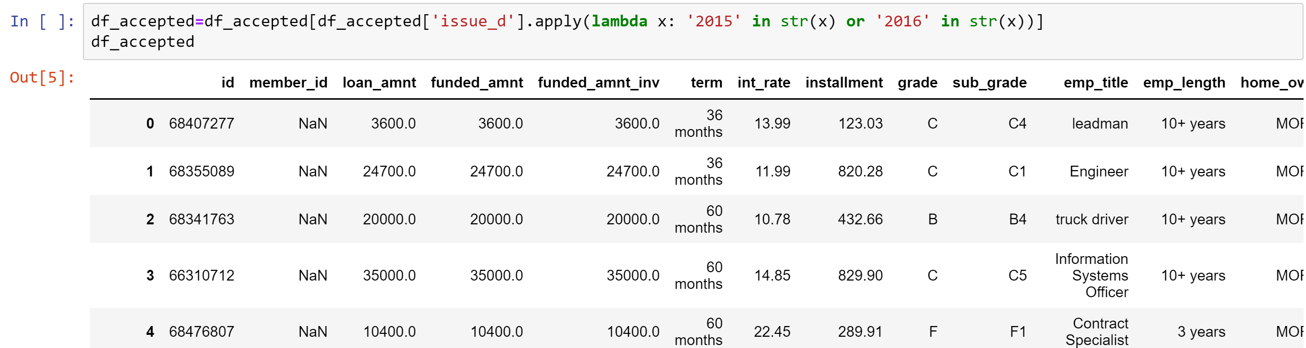
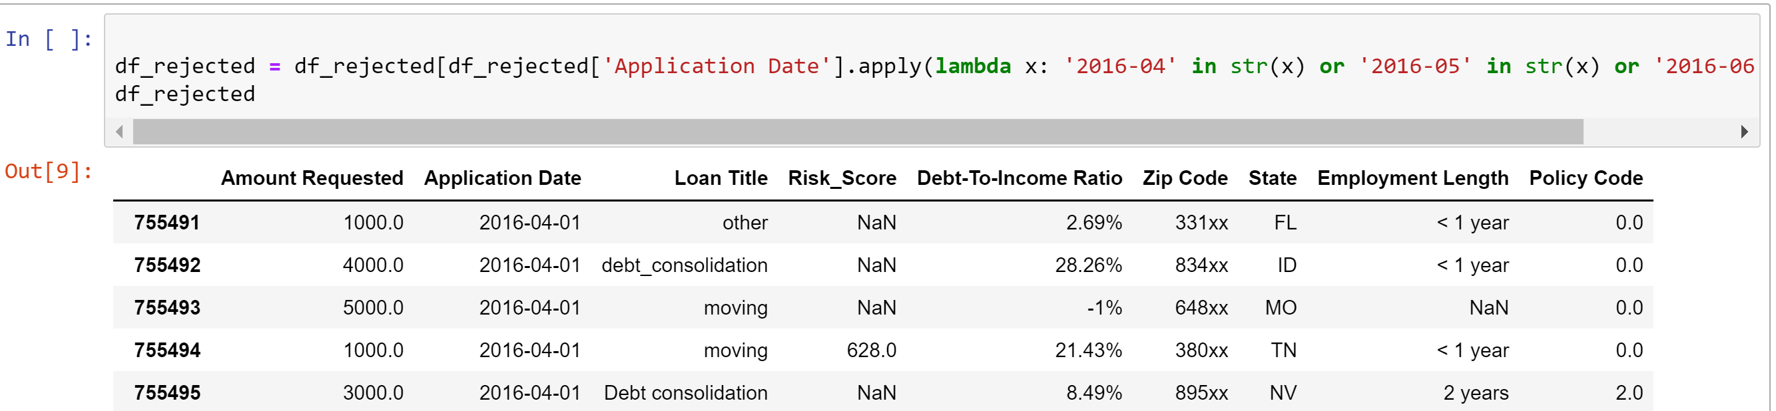
Exploratory Data Analysis – Data Wrangling

Slide 9
Exploratory Data Analysis – Data Wrangling
DTI
addr_state
Debt-to-Income-Ratio
State
fico-range_(low and high)
Risk Score
‘accepted…’ dataset
‘rejected…’ dataset

Slide 10
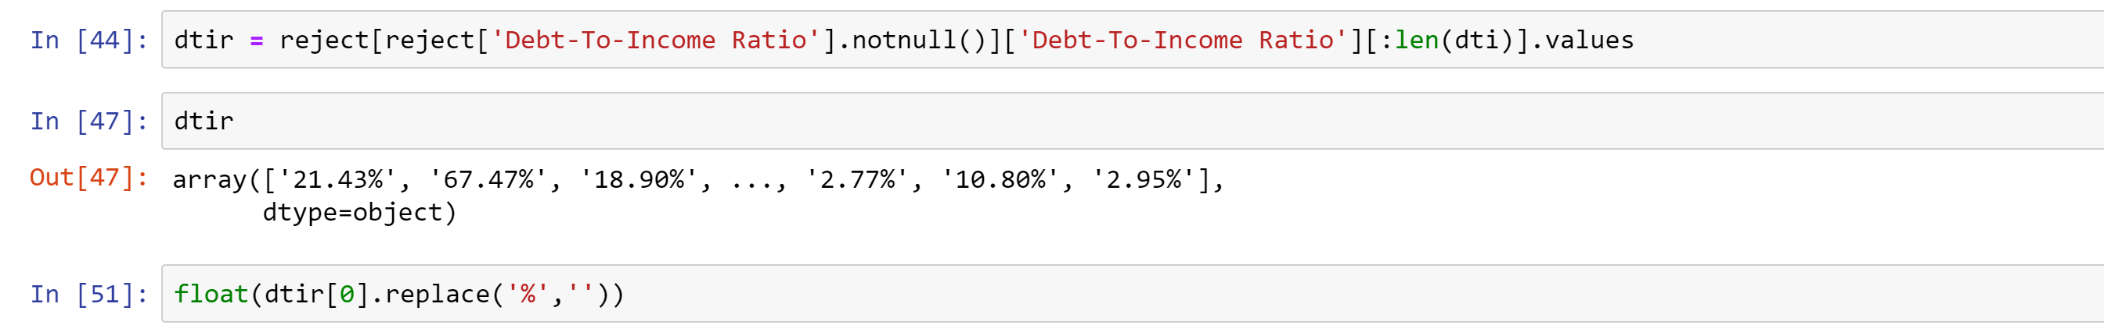
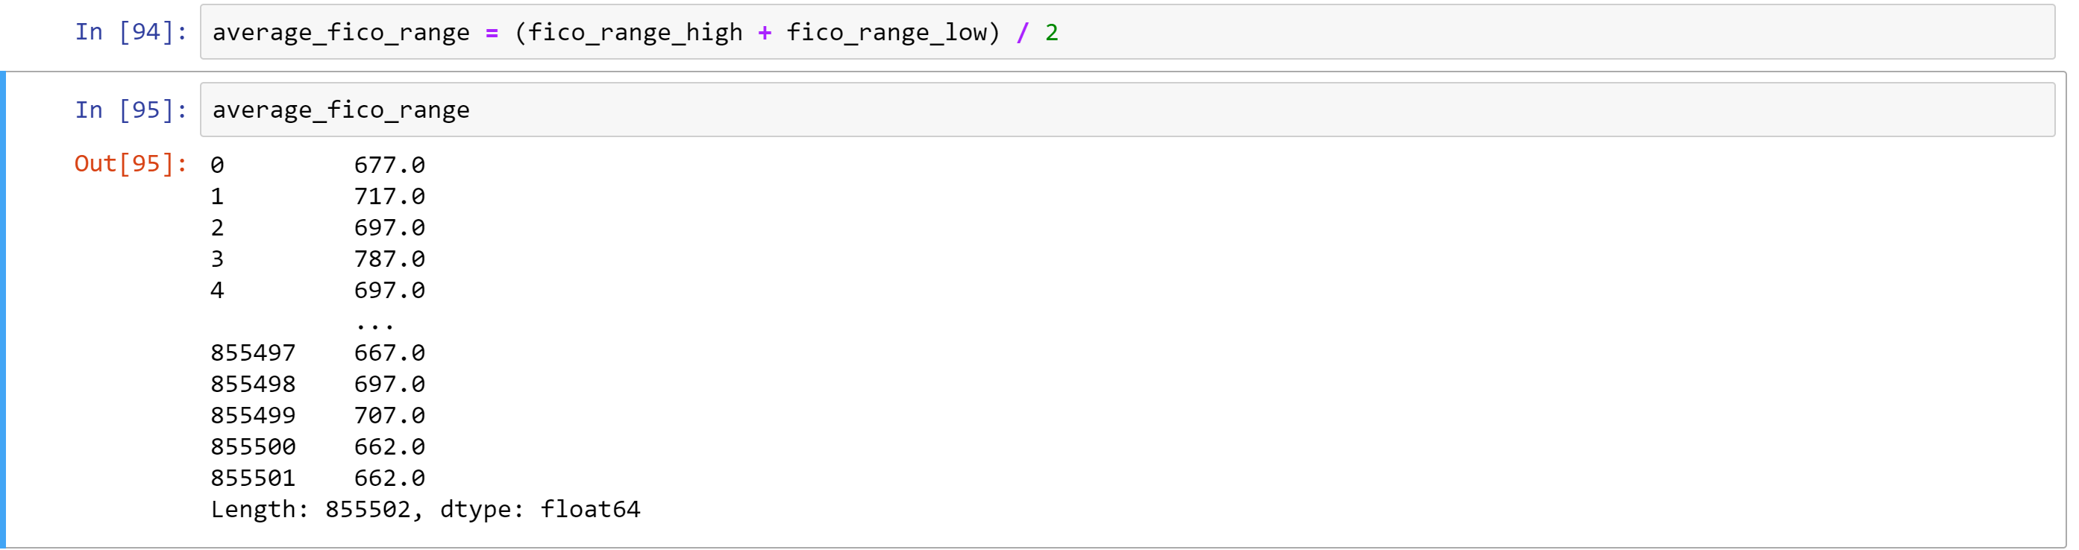
Exploratory Data Analysis – Data Wrangling

Slide 11
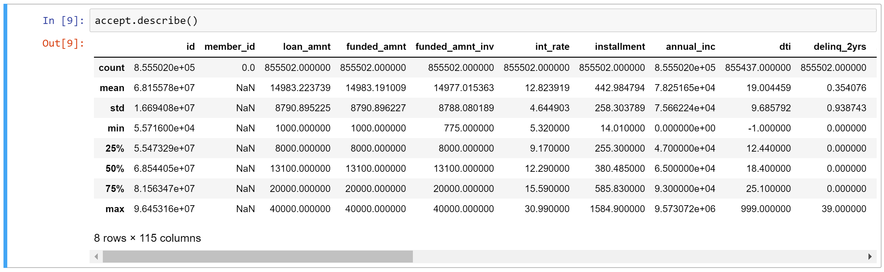
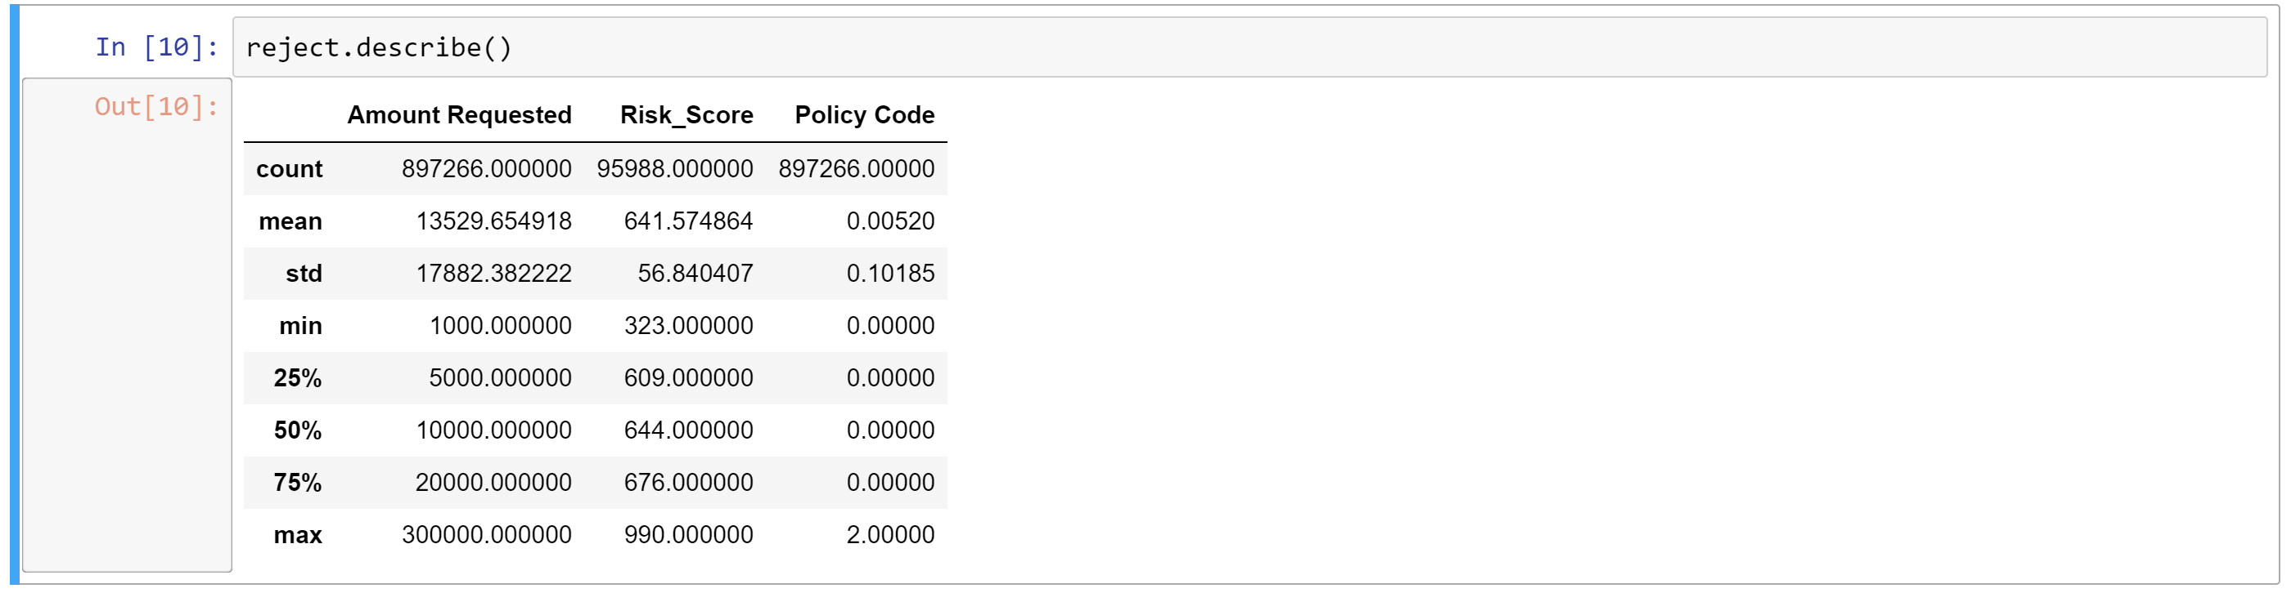
Exploratory Data Analysis – Descriptive Statistics

Slide 12
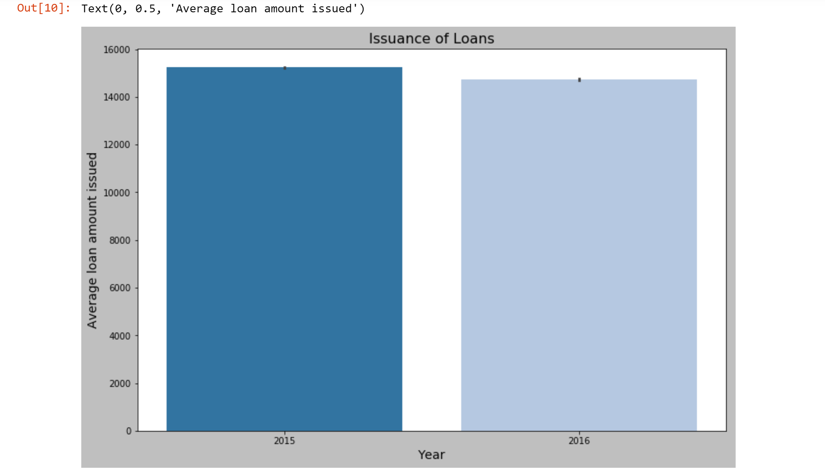
Data Snapshot - Loan approvals from 2015 to 2016

Slide 13
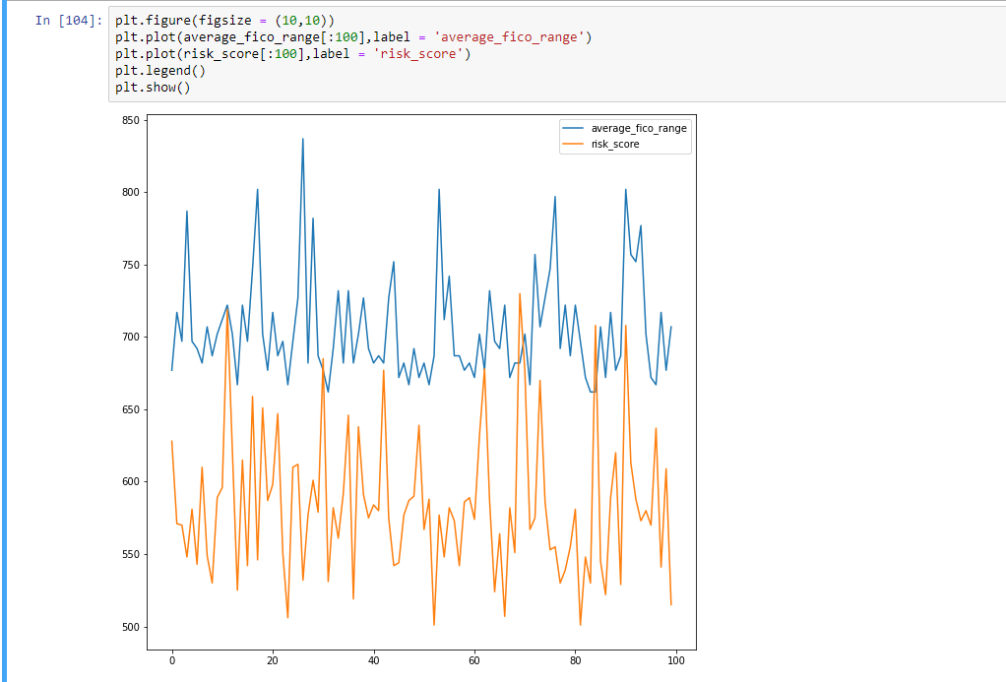
Possible Opportunity for Increased Productivity – FICO Risk Score

Slide 14
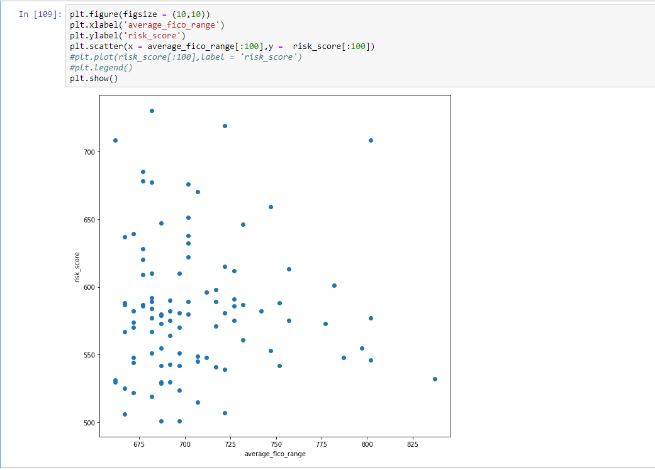
Possible Opportunity for Increased Productivity – FICO Risk Score

Slide 15
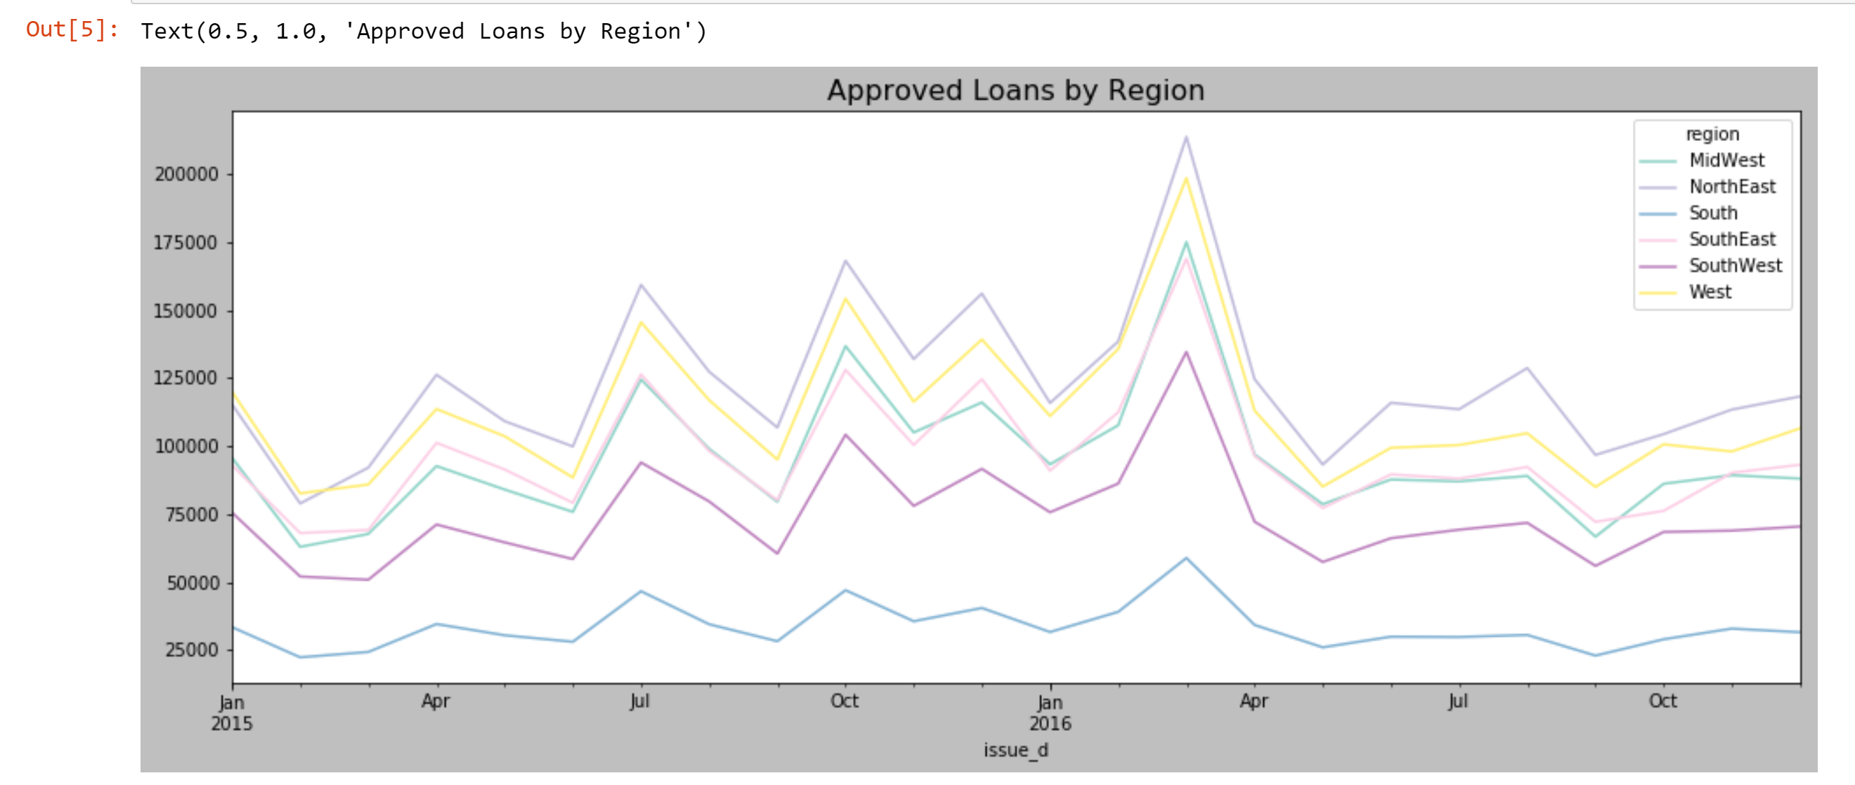
Possible Opportunity for Increased Productivity – Regional Markets

Slide 16
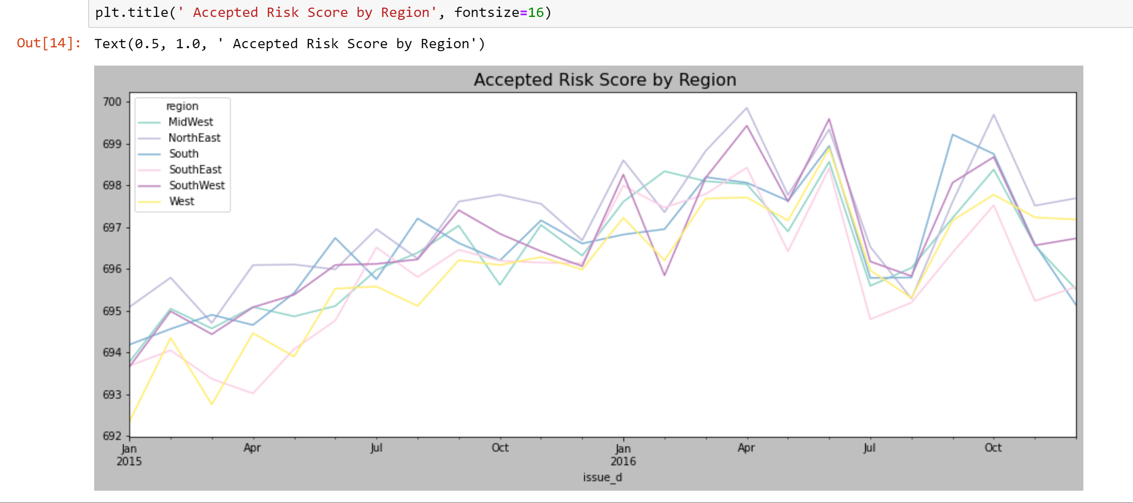
Possible Opportunity for Increased Productivity – Regional Markets

Slide 17
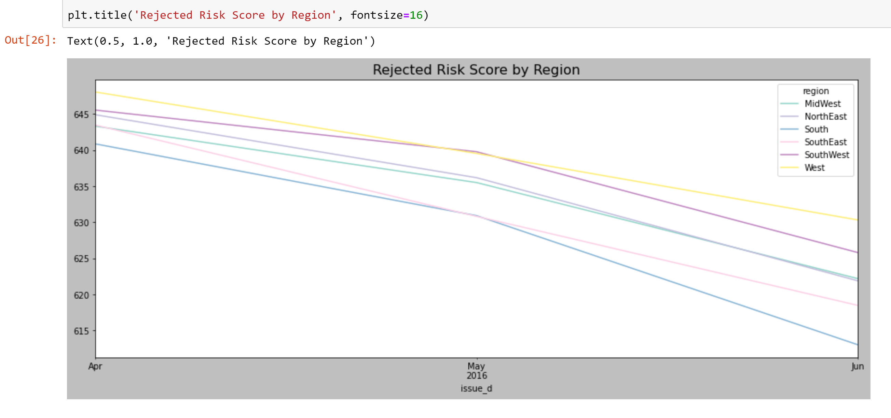
Possible Opportunity for Increased Productivity – Regional Markets

Slide 18
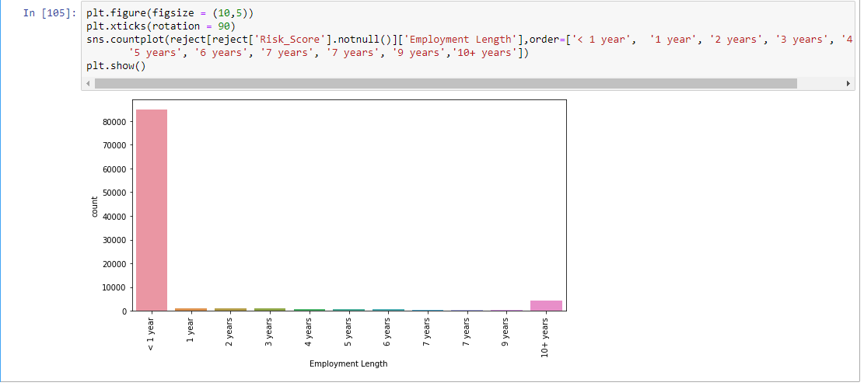
Possible Opportunity for Increased Productivity – Employment Length

Slide 19
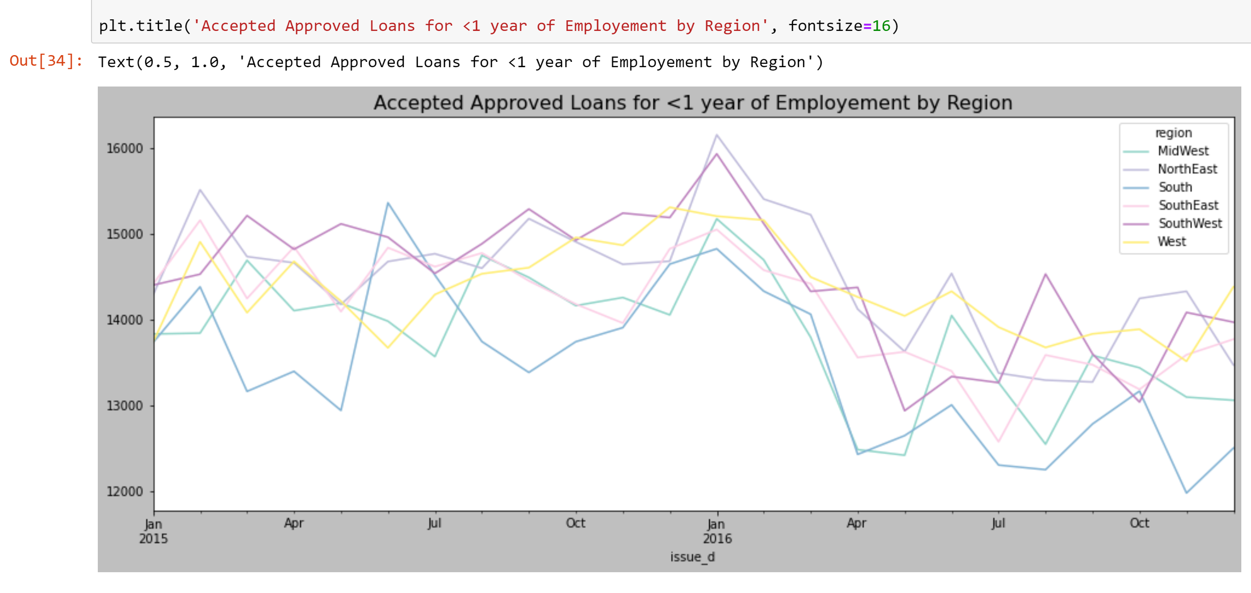
Possible Opportunity for Increased Productivity – Employment Length

Slide 20

Summary
1
Opportunity to increase new loans by FICO risk scores
2
Opportunity to increase new loans by regional markets
3
Opportunity to increase new loans by length of employment

Slide 21

Questions
Name:
James Rogers
Phone:
555-555-5555
Email:
james.rogers@divergence.one

Slide 22


Trend Analysis
Transition:
From the Nature of Crime on to Trend Analysis

